Slide 1
GPS-TELEMETRİ-MOTOR

Slide 2
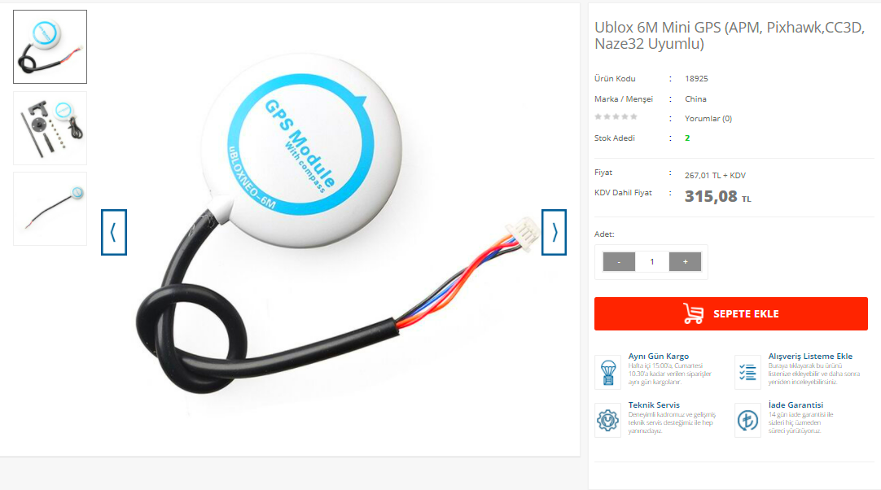
GPS
1-Ublox 6M Mini GPS (APM, Pixhawk,CC3D, Naze32 Uyumlu)

Slide 3
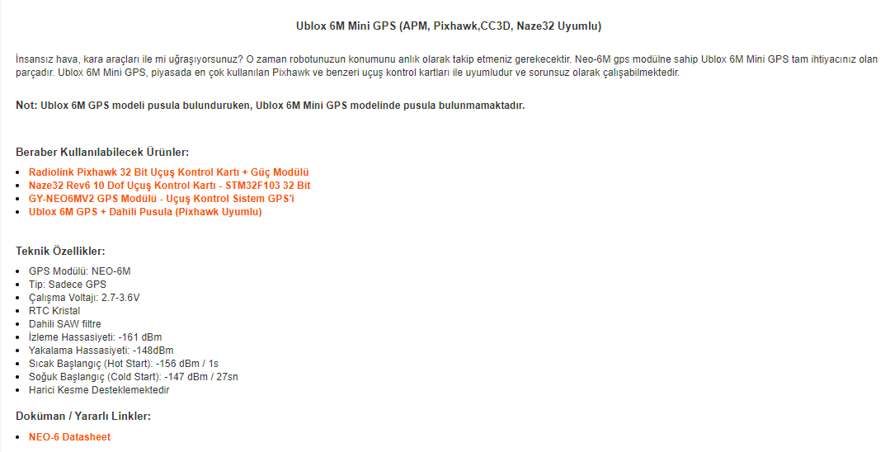
https://www.robotistan.com/ublox-6m-mini-gps-apm-pixhawkcc3d-naze32-uyumlu

Slide 4
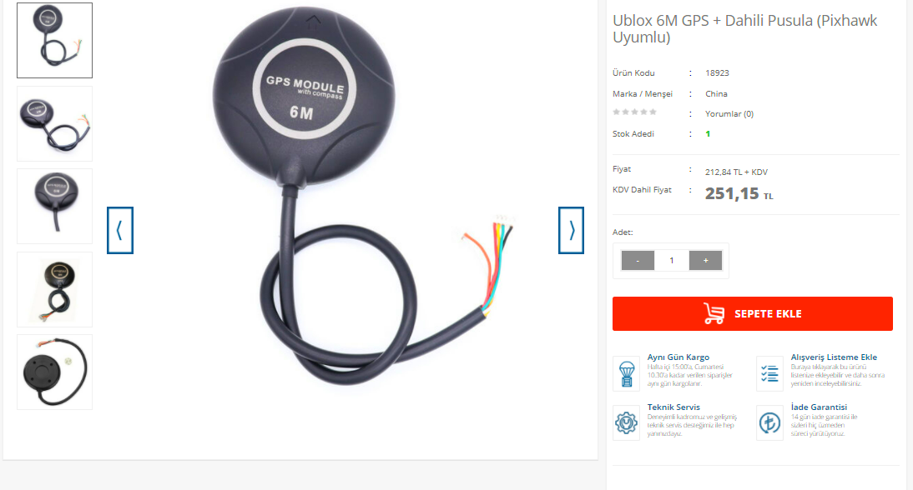
2-Ublox 6M GPS + Dahili Pusula (Pixhawk Uyumlu)

Slide 5
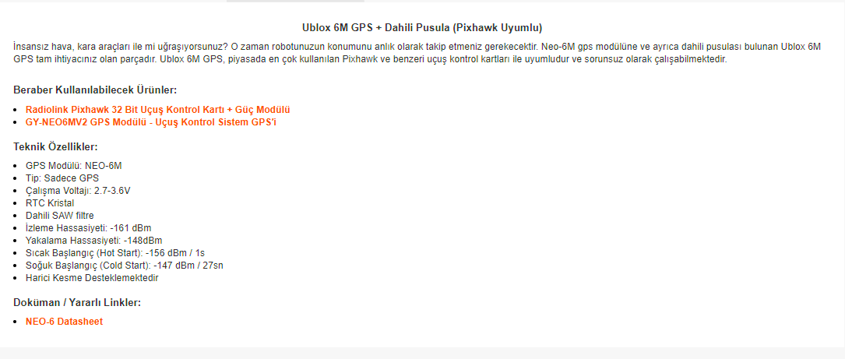
https://www.robotistan.com/ublox-6m-gps-dahili-pusula-pixhawk-uyumlu?language=tr&h=cedb6c14

Slide 6
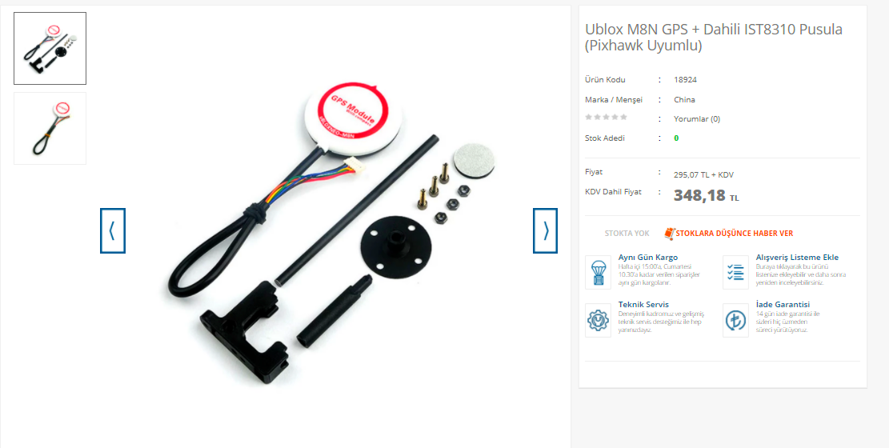
3-Ublox M8N GPS + Dahili IST8310 Pusula (Pixhawk Uyumlu)

Slide 7
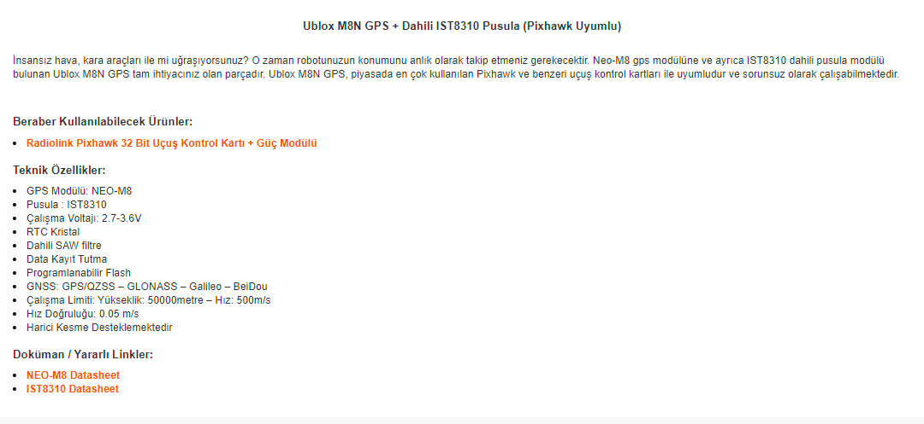
https://www.robotistan.com/ublox-m8n-gps-dahili-ist8310-pusula-pixhawk-uyumlu

Slide 8
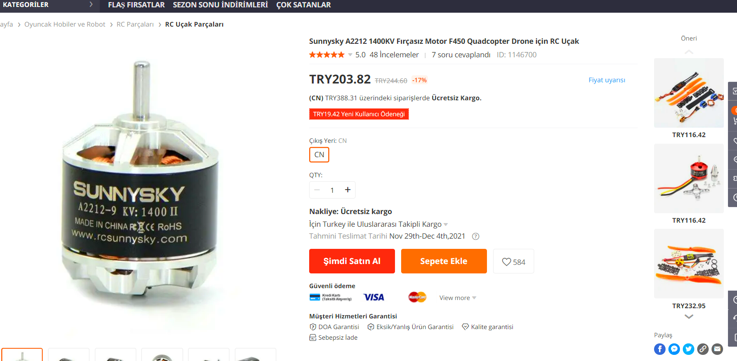
MOTOR
1-Sunnysky A2212 1400KV Fırçasız Motor F450 Quadcopter Drone için RC Uçak

Slide 9
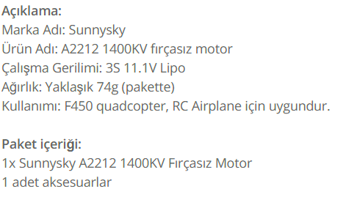
https://tr.banggood.com/Sunnysky-A2212-1400KV-Brushless-Motor-For-F450-Quadcopter-Drone-RC-Airplane-p-1146700.html?gmcCountry=TR&currency=TRY&cur_warehouse=CN&createTmp=1

Slide 10
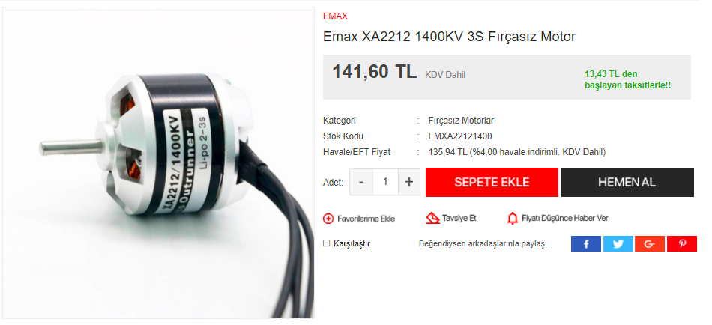
2-Emax XA2212 1400KV 3S Fırçasız MotoR

Slide 11
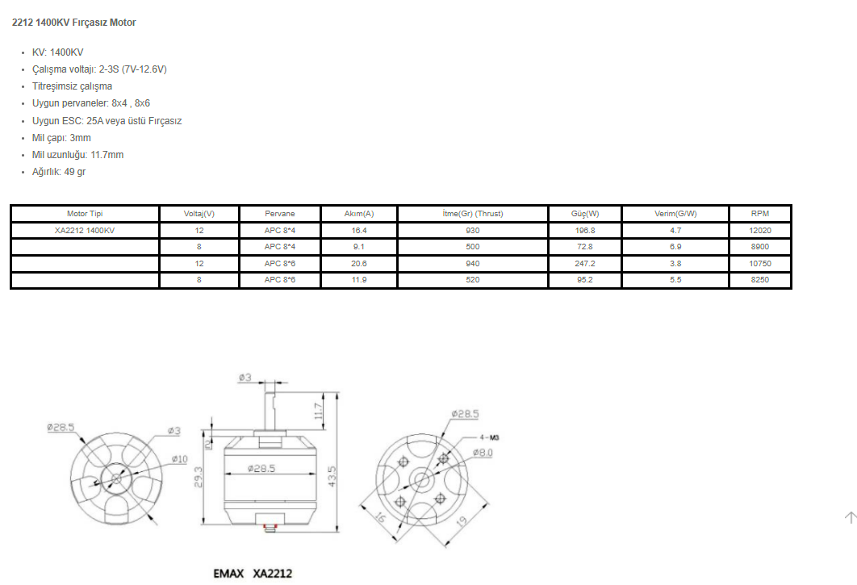
https://www.promodelhobby.com/urun/emax-xa2212-1400kv-3s-fircasiz-motor

Slide 12
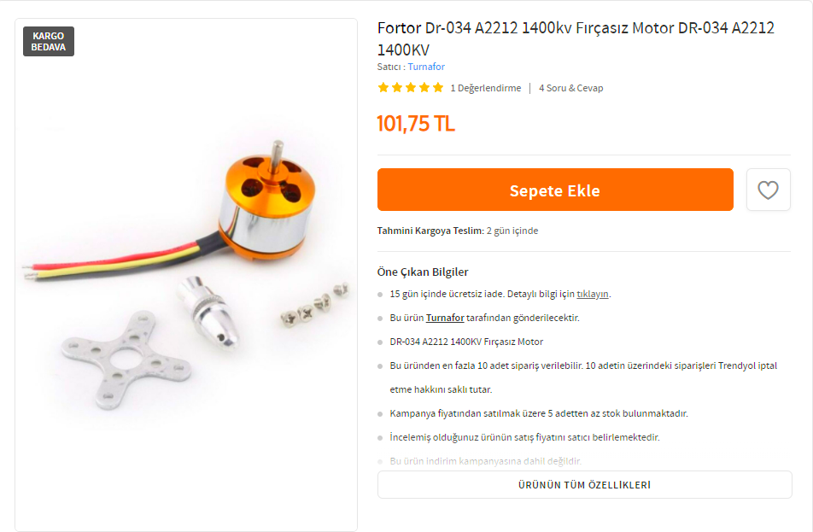
3-Fortor Dr-034 A2212 1400kv Fırçasız Motor DR-034 A2212 1400KV
https://www.trendyol.com/fortor/dr-034-a2212-1400kv-fircasiz-motor-p-96335430?boutiqueId=61&merchantId=117107

Slide 13
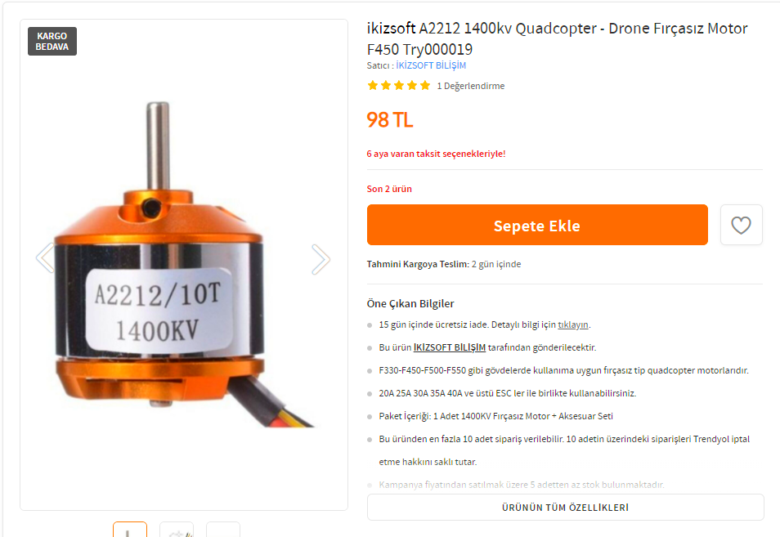
4-ikizsoft A2212 1400kv Quadcopter - Drone Fırçasız Motor F450 Try000019
https://www.trendyol.com/ikizsoft/a2212-1400kv-quadcopter-drone-fircasiz-motor-f450-p-44831568?boutiqueId=61&merchantId=121375

Slide 14
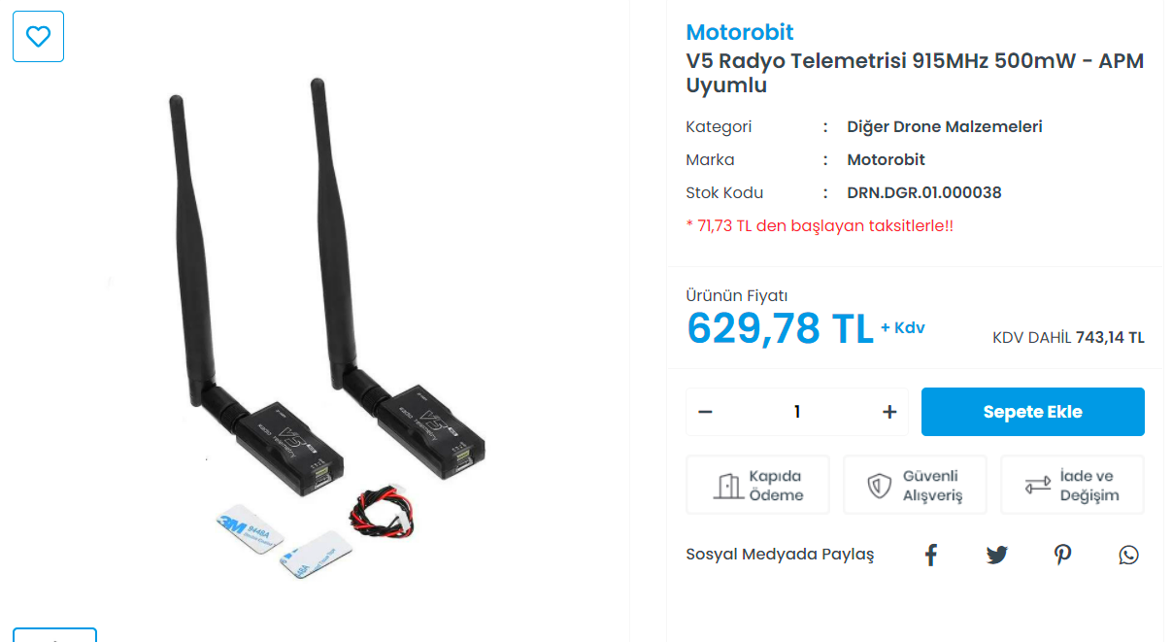
TELEMETRİ
1-Motorobit
V5 Radyo Telemetrisi 915MHz 500mW - APM Uyumlu

Slide 15
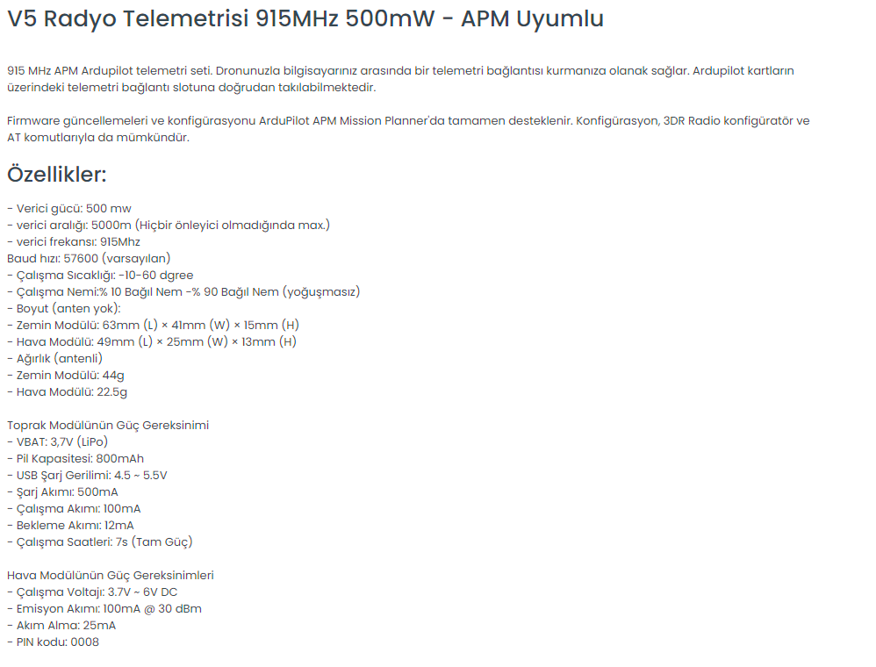
https://www.motorobit.com/urun/v5-radyo-telemetrisi-915mhz-500mw-apm-uyumlu

Slide 16
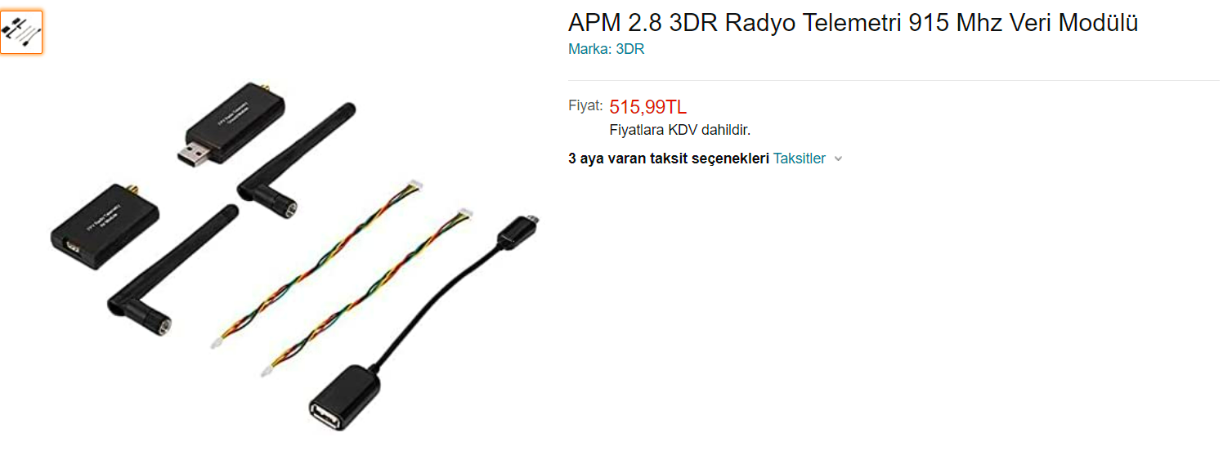
2-APM 2.8 3DR Radyo Telemetri 915 Mhz Veri Modülü
https://www.amazon.com.tr/3DR-Radyo-Telemetri-Veri-Mod%C3%BCl%C3%BC/dp/B092VK9NXT/ref=asc_df_B092VK9NXT/?tag=trshpngglede-21&linkCode=df0&hvadid=510123464582&hvpos=&hvnetw=g&hvrand=17076692624941287271&hvpone=&hvptwo=&hvqmt=&hvdev=c&hvdvcmdl=&hvlocint=&hvlocphy=1012782&hvtargid=pla-1340200961930&psc=1

Slide 17
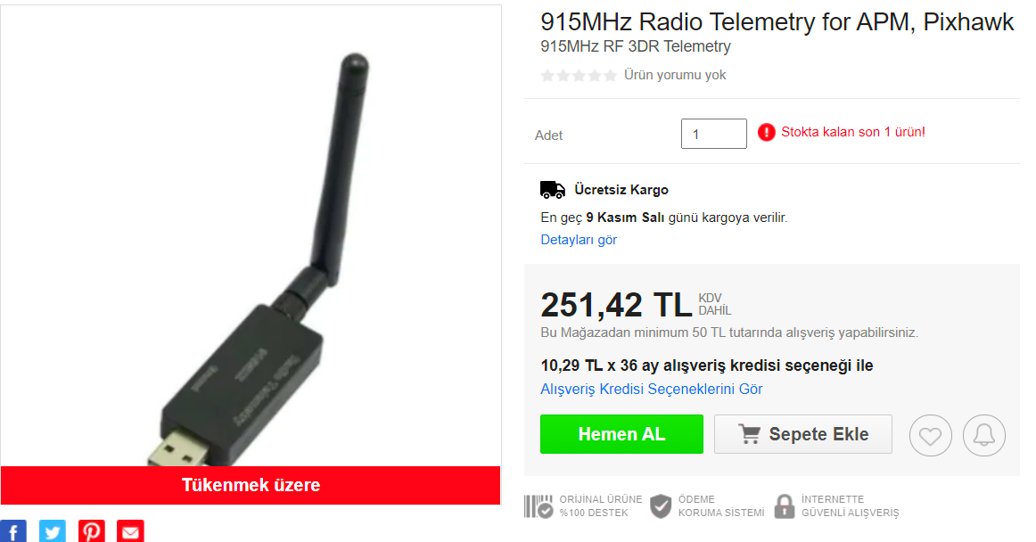
3-915MHz Radio Telemetry for APM, Pixhawk

Slide 18
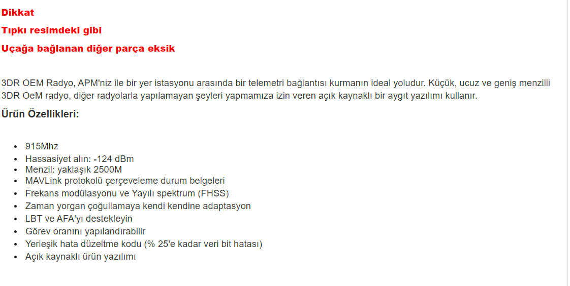
https://urun.n11.com/drone-aksesuarlari-ve-yedek-parca/915mhz-radio-telemetry-for-apm-pixhawk-P473631541?gclsrc=aw.ds&gclid=Cj0KCQjw5oiMBhDtARIsAJi0qk3pPmm6y1awkVM9e1HGzKj46KcMl3Q_Nt_oEwWBrPgK-VHNUezq4hoaApo6EALw_wcB

